Slide 1
Self-Care Strategies for Graduate Students

Slide 2
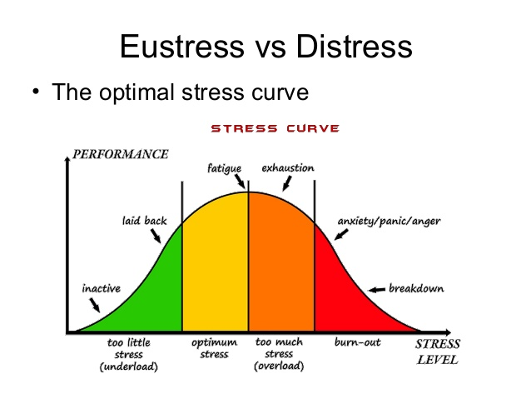
Stress
Body’s natural reaction to any perceived demands or threats - physical, mental, or emotional - that is placed upon it
Notes:
Eustress is positive and beneficial. We may feel challenged, but the sources of the stress are meaningful opportunities Examples of eustress include graduating from college, getting married, receiving a promotion, or changing jobs.
Distress is a continuous experience of feeling overwhelmed, oppressed, and behind in our responsibilities. Examples of distress include financial difficulties, conflicts in relationships, excessive obligations, managing a chronic illness, or experiencing a trauma.

Slide 3
Causes of Stress
Environmental factors
Changes/Transitions
Social factors
Your thoughts
Physiological factors
Notes:
Environmental factors (weather, noise, traffic)
Changes/Transitions (work, school, relationships)
Social factors (deadlines, finances, interpersonal conflict)
Your thoughts (the way your brain interprets changes in the environment and determines when to turn on the stress response)
Physiological factors (lack of sleep, poor nutrition, illness, injuries, headaches, anxiety, depression)

Slide 4
What does stress feel like for you?
Emotional signs: Feelings of anxiety, anger, sadness, frustration
Behavioral signs: trouble sleeping, irritability, aggression, crying
Physical signs: nausea, indigestion, increased heart rate, perspiration, breathing changes

Slide 5
Managing Stress Effectively
Two Types of Coping Strategies
Problem Focused – reducing or eliminating stressor or the cause of the problem
Emotion Focused – reducing or preventing emotional reaction, managing feelings
Active versus Distractive
Active – awareness of the problem and going through steps to reduce a negative outcome
Distractive – ignoring the issue, or denial of the problem
Notes:
Problem - Make list, establish boundaries, walk away, improv time management, reach out for help
Emotion - Clean, yoga, music, exercise, play with pets, hang w/friends, use humor

Slide 6
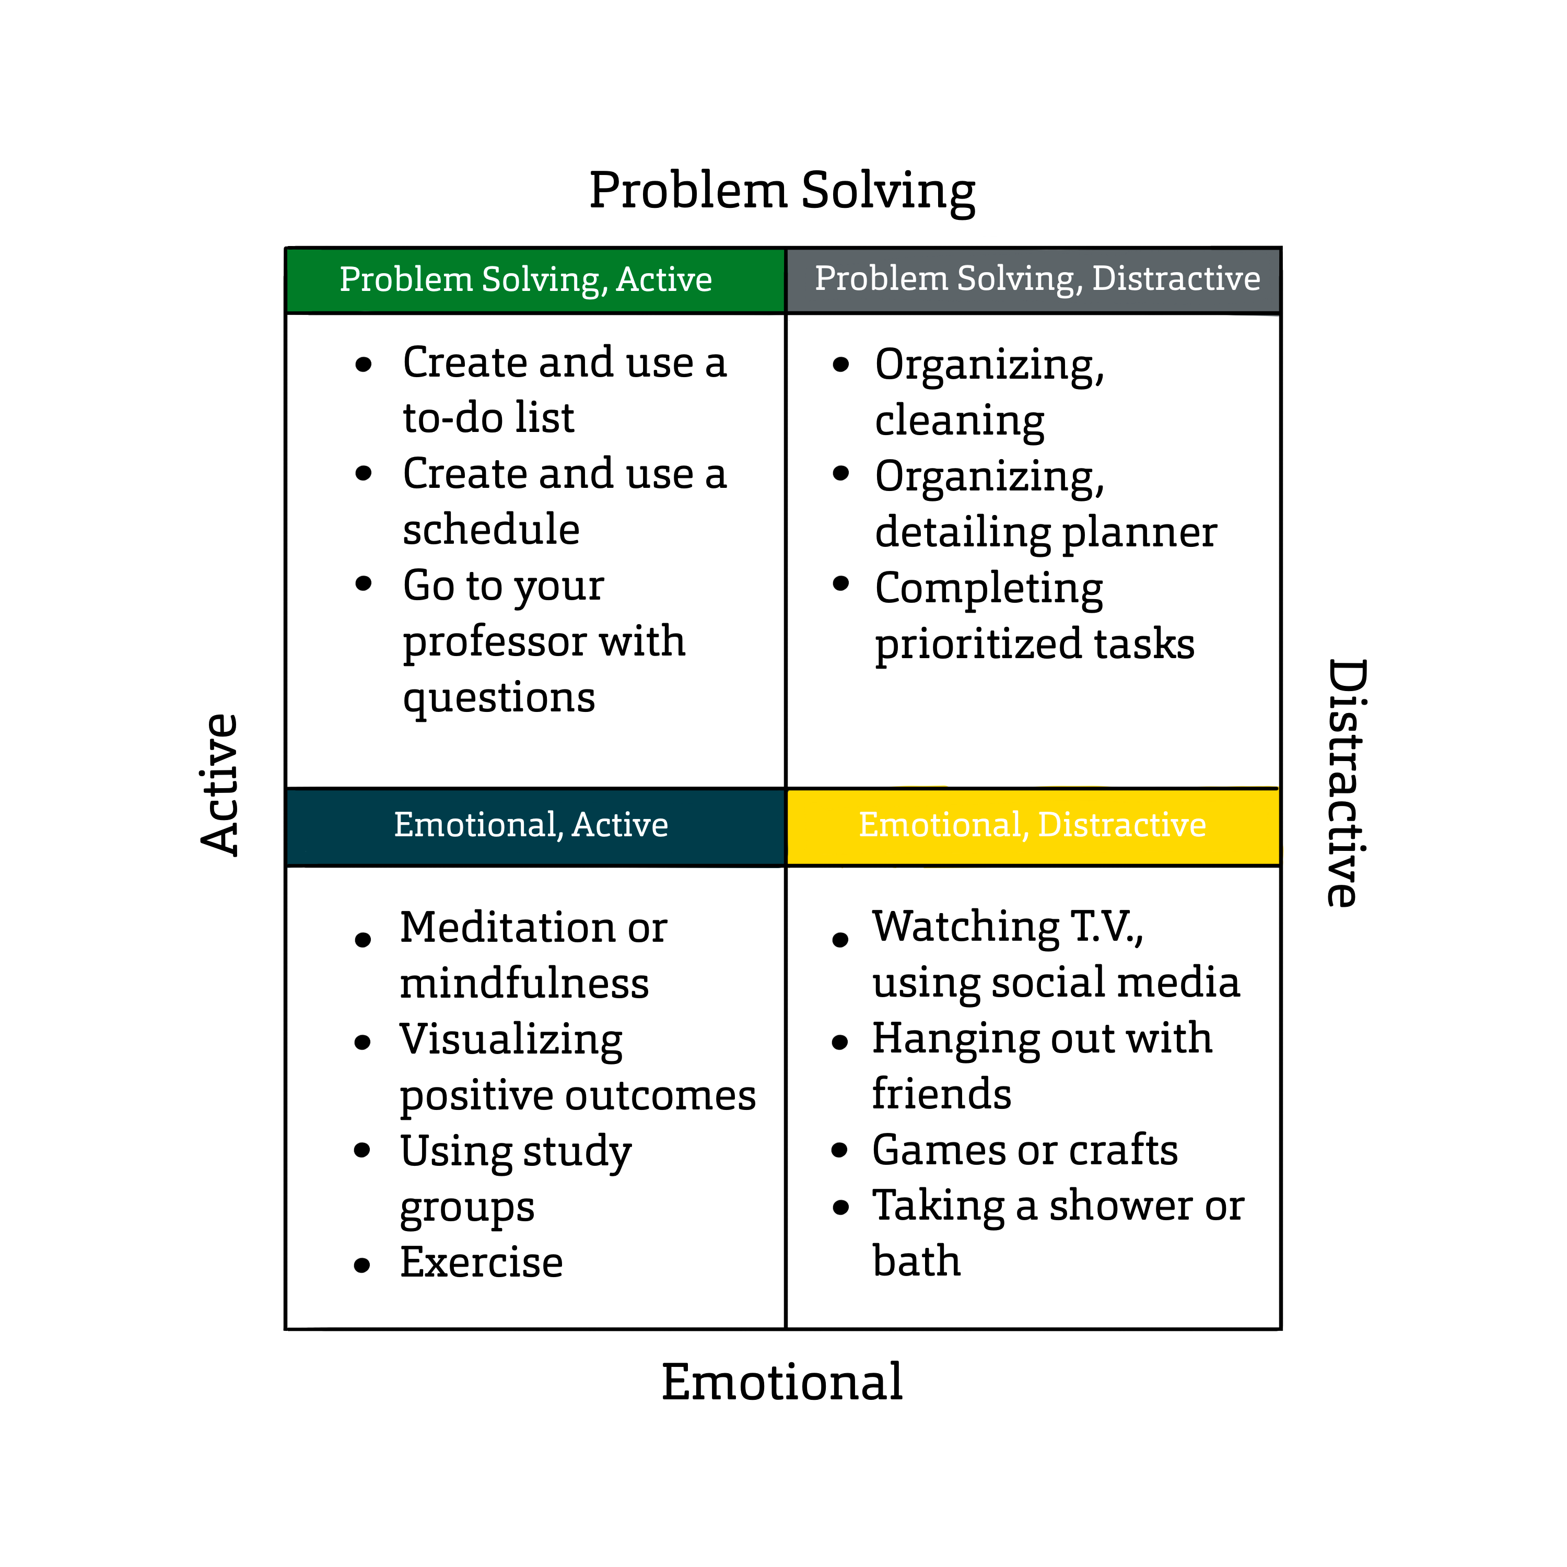

Slide 7
Strategies to manage stress
Yoga
Self-Massage
Progressive Relaxation
Mental Imagery
Notes:
Mental imagery – technique of focusing on positive images in your mind (script below)
Keep your eyes closed, now picture the following:
•Imagine that you are in the park sitting under a tree during the spring season. The breeze is cool across your face; you are listening to one of your favorite songs, and you can hear the birds singing.
•Think about how it smells, looks, sounds, and feels
•When you are ready, open your eyes.
How did that feel, were you thinking about anything else during that mental imagery session? This is similar to meditation, only meditation attempts to push out all imagery and thoughts. It takes practice.

Slide 8
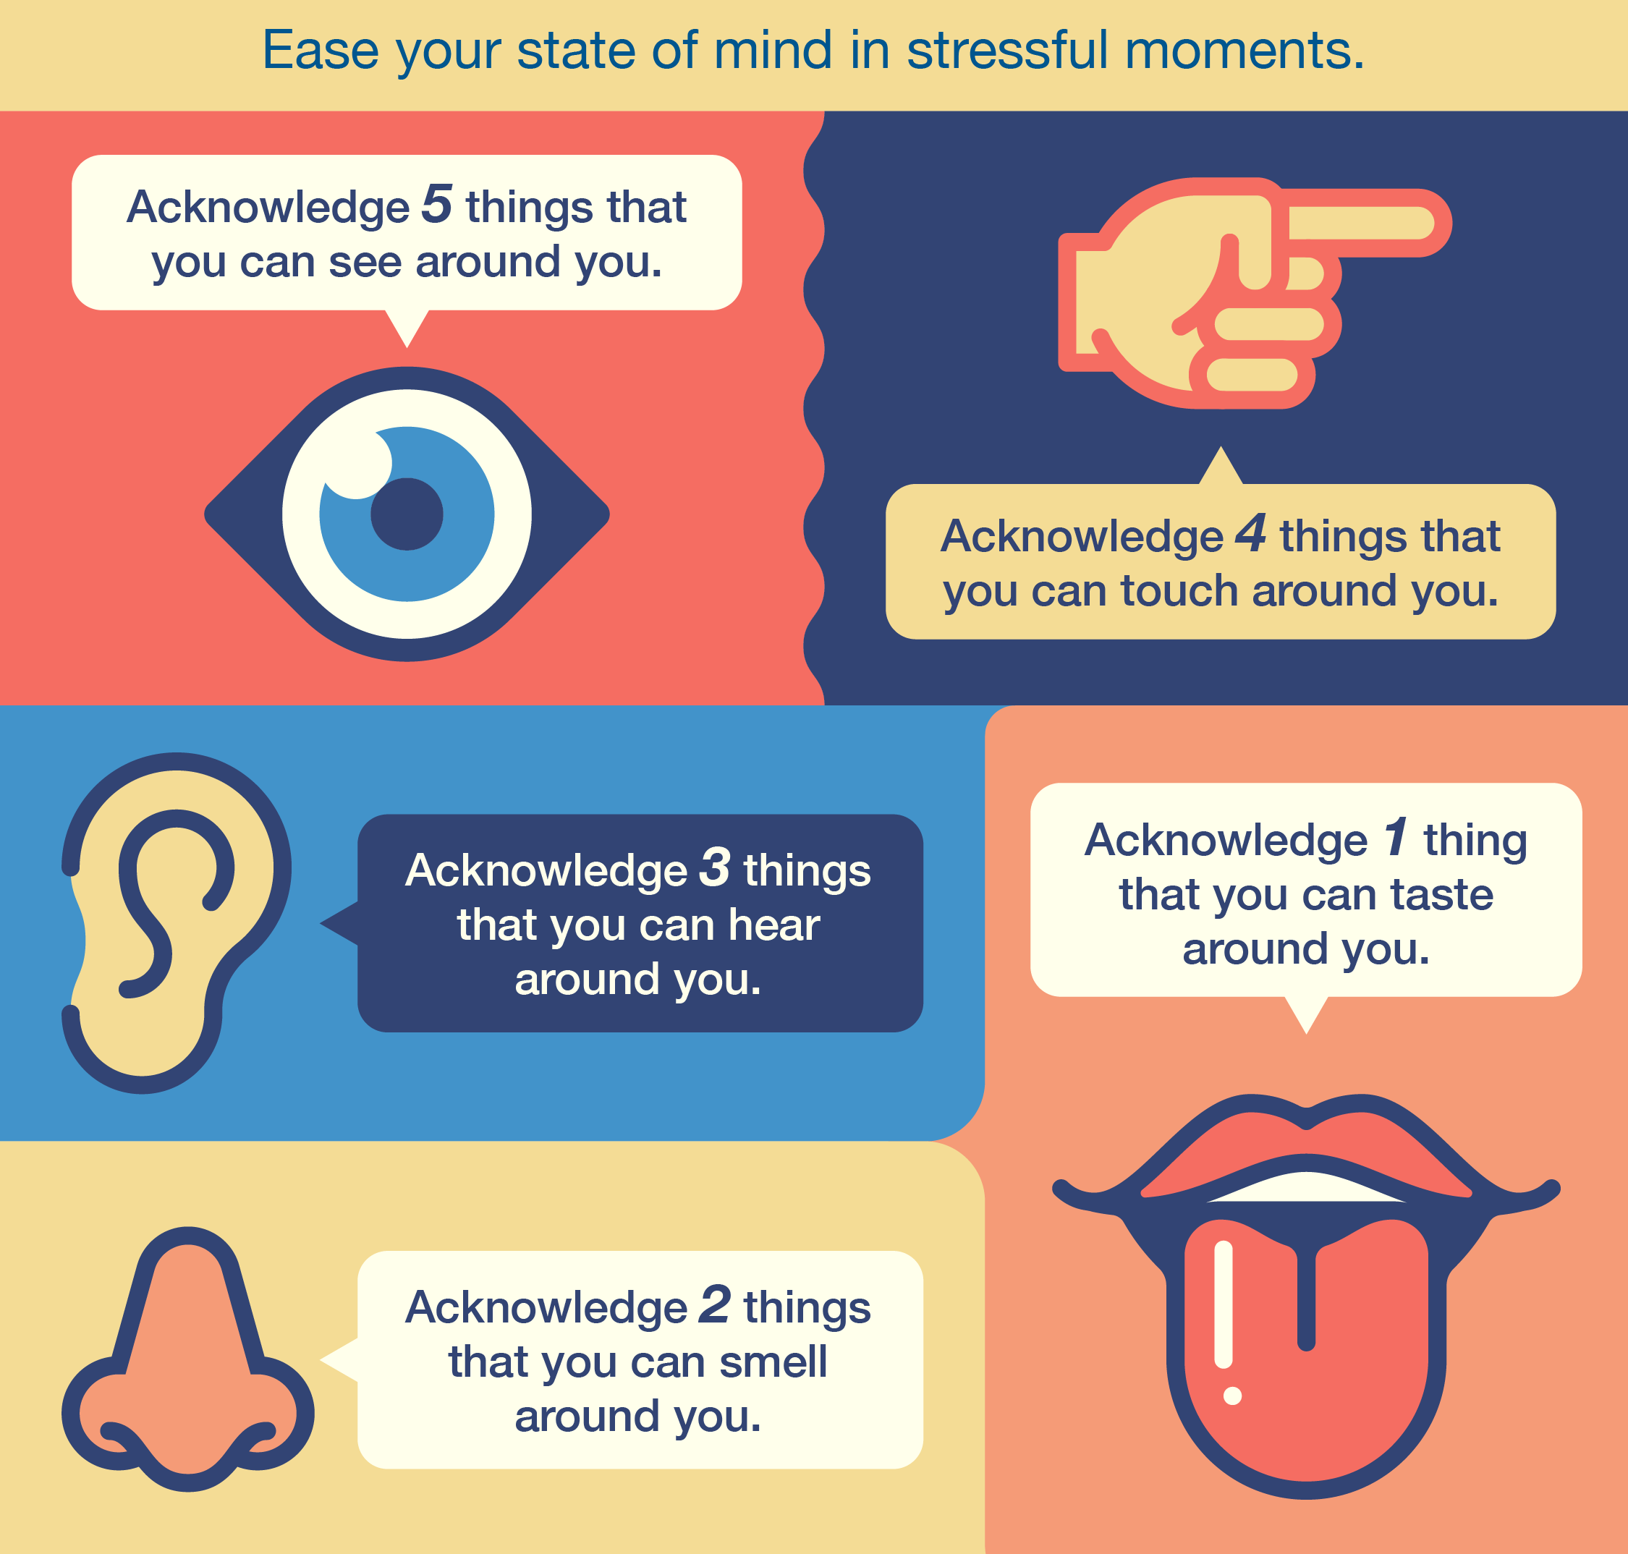
Strategies - Grounding

Slide 9
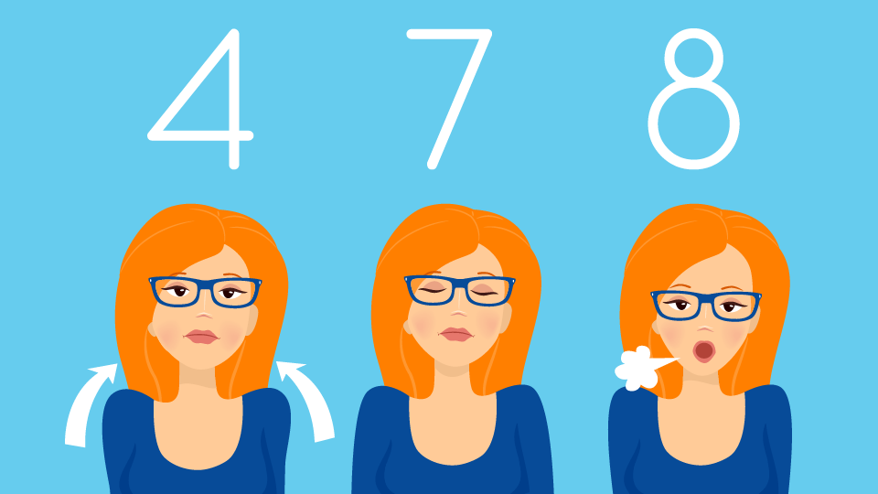
Strategies - Breathing

Slide 10
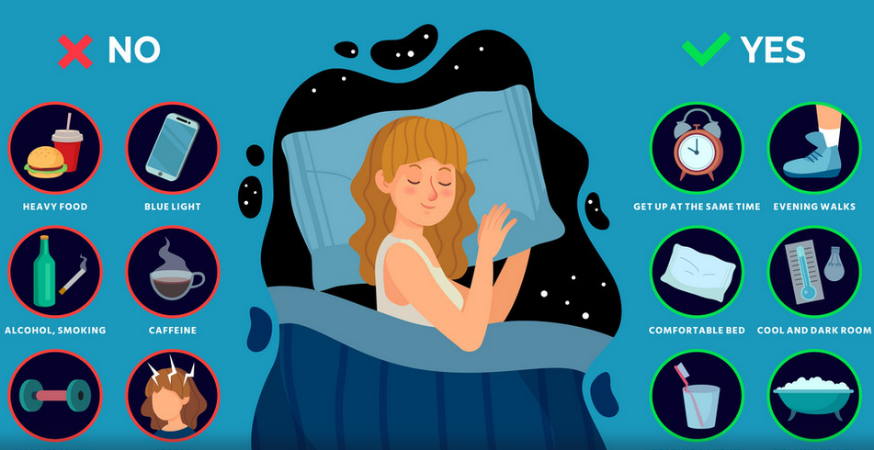
Strategies - Getting Better Sleep
Notes:
Try to wake up around the same time every day
Turn off electronics/screens at least 30 min. before bedtime
Try to maintain a regular pre-bed routine to prepare the brain for sleeping
Make your room as dark as you can tolerate
Turn the ringer of your phone off
Avoid caffeine after 3PM
If needing background noise from a TV or other source, use the sleep timer to avoid noise that will disrupt your sleep cycle

Slide 11
Supportive Resources on Campus
Miner Wellness
203 Norwood Hall
320 W. 12th Street
minerwellness@mst.edu
573-341-4225
Counseling Services
204 Norwood Hall 320 W. 12th Street
counsel@mst.edu
573-341-4211
Care Management
107 Norwood Hall
320 W. 12th Street
ucare@mst.edu
573-341-4209
Student Health
910 W. 10th Street
mstshs@mst.edu
573-341-4284

Slide 12
Supportive Resources on Campus
University Committee for Assistance, Response, and Evaluation (UCARE)
Members of the campus community are encouraged to make a UCARE referral when they are concerned about a student, regardless of how insignificant the concern may seem. https://go.mst.edu/ucare-report/
Well-Being Quick Reference Guide
https://minerwellness.mst.edu/well-being-reference-guide/

